Slide 1
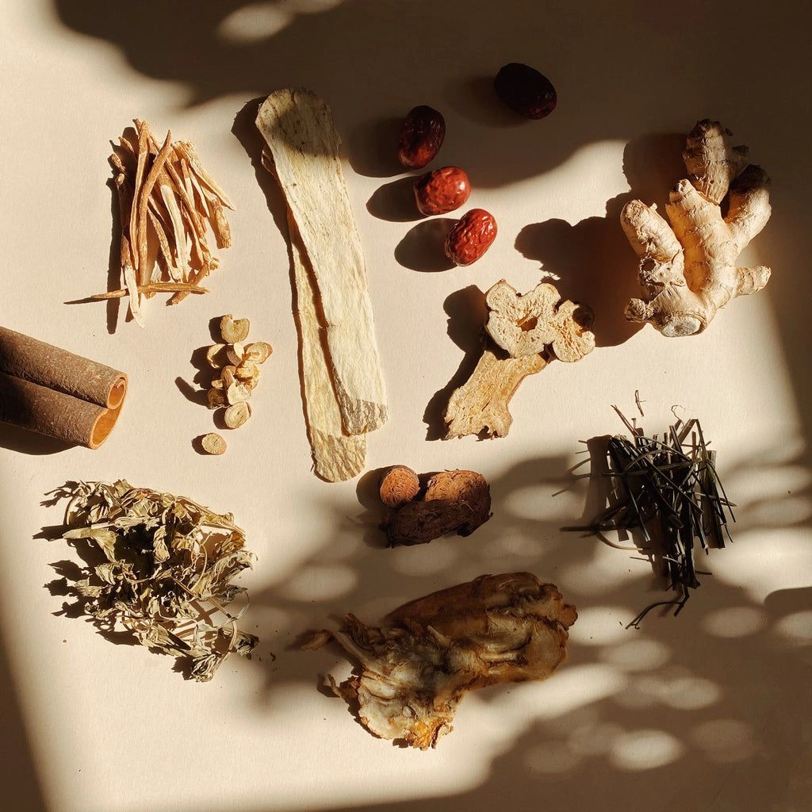



MKT-0305
The Future of Commerce
The Art of Rejuvenating the Brand
Presented To:
Prof. Nikhil Soi
Prepared for:
Anita Kaushal
Team
3
Kartavya Jharwal, Marcella Ibanhez, Yasmim Souza, Olta Abdyli, Adar Aksak, Ali Sarp Acar, Zuzanna Zalicka

Slide 2
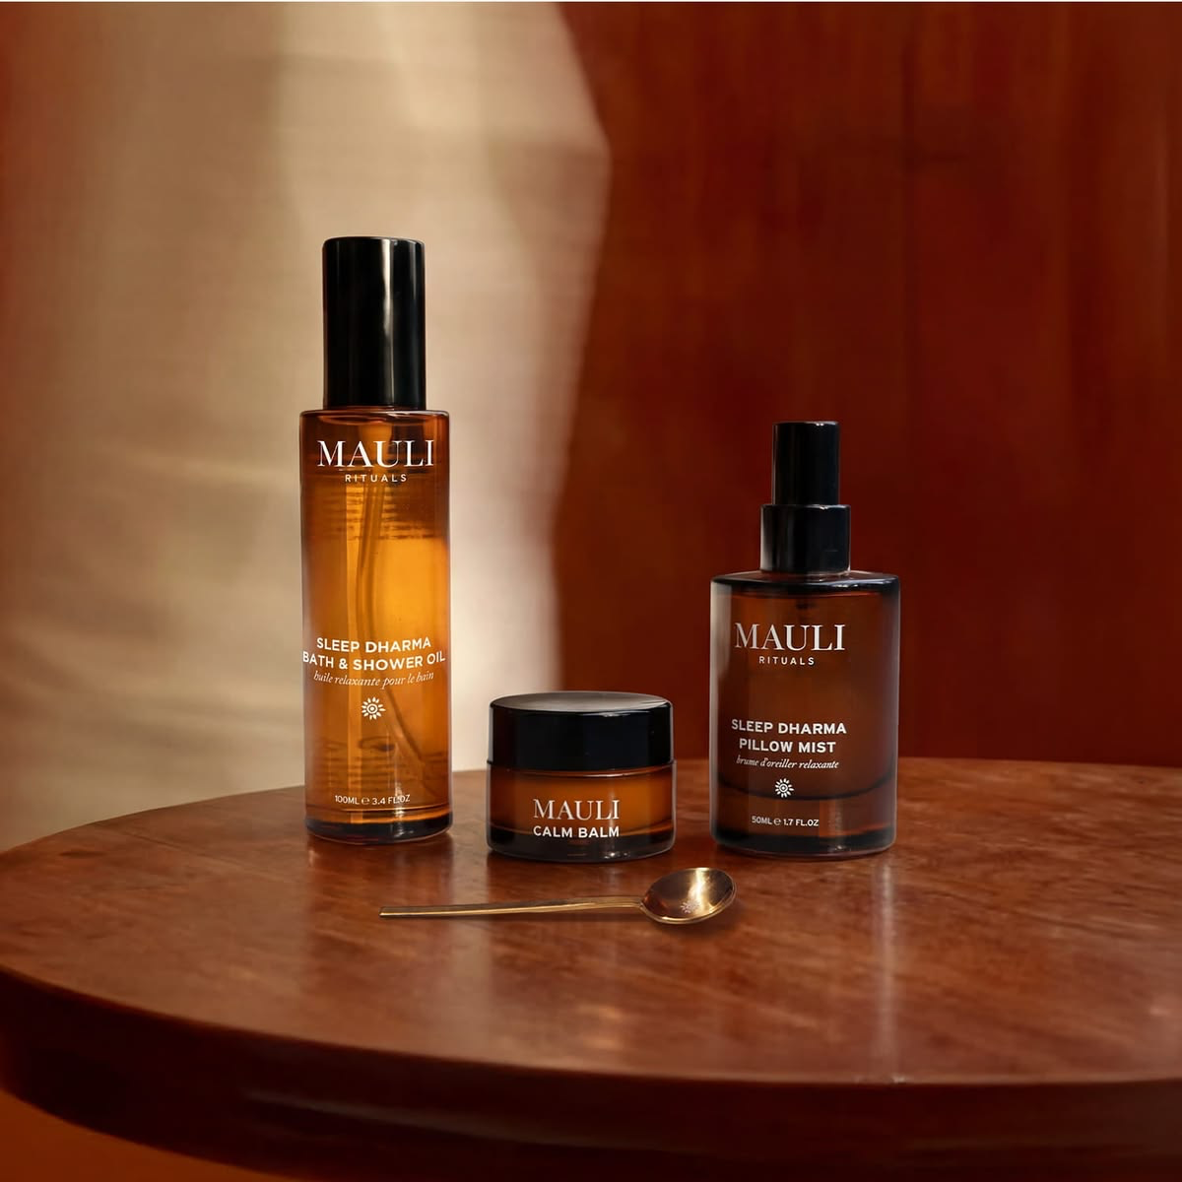

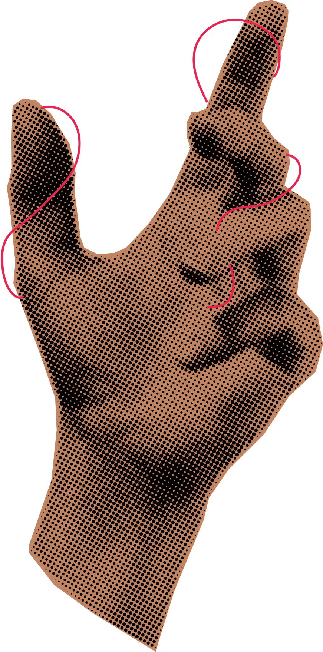
make the
thread
the ritual
“The Ritual” Connects
the brand altogether

Slide 3
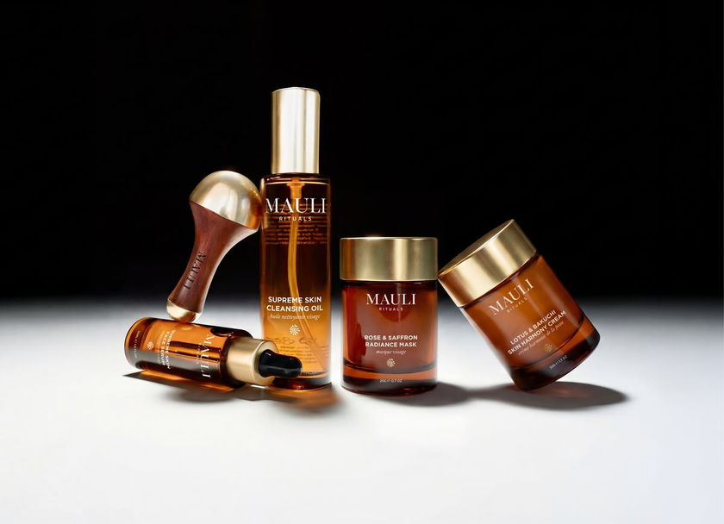
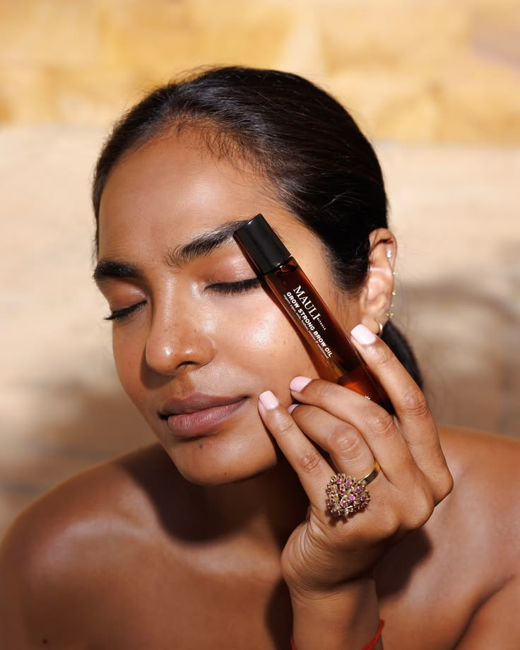
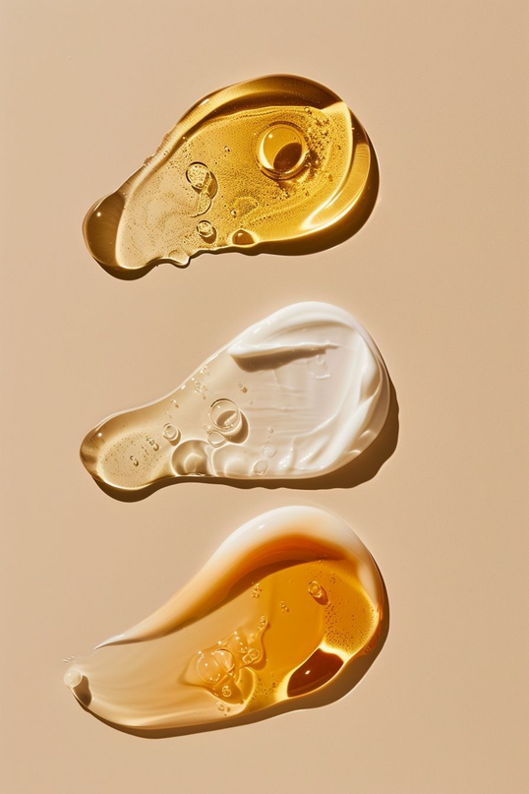
The Problem x Opportunity
How do we scale the brand without stripping it of cultural ayurveda, founder led story or sensory engagement
Quantity ≠ Quality
OPPORTUNITY
  Mauli surfaces in Ayurveda and dosha prompts: own that territory
  Repeat is the profit engine, and the 54% repeat rate is the base to build on
  Real recorded expertise of Anita and Bittu are the human edge
PROBLEMS
  AI assistants describe Mauli without Mauli: named in only 2 of 8 category answers
  The quiz picks by fixed rules, not stock: it recommended a sold-out £244 set
  The first order is near breakeven, with 72% of marketing spend on Meta

Slide 4
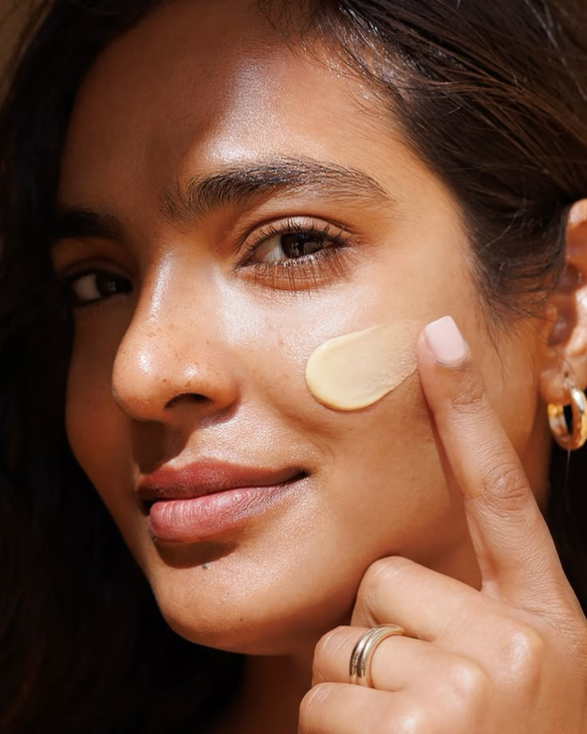
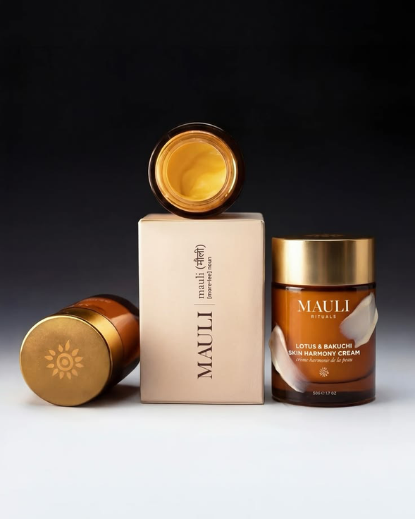
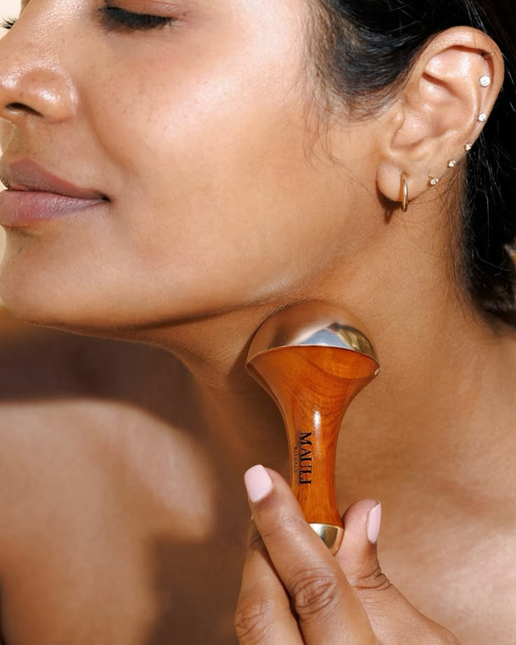
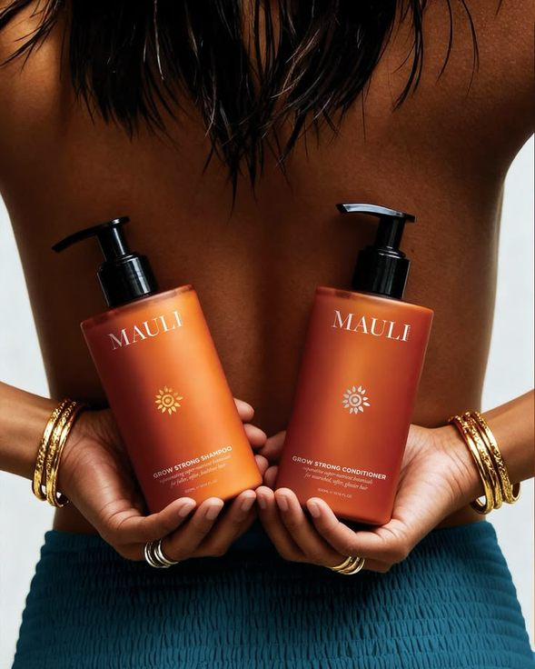

The Diagnosis
Core Concepts Analysis
WHERE MAULI IS EXPOSED TO ALGORITHMS AND AGENTS
MEANING GETS LOST BETWEEN BRAND AND ALGORITHM
WHERE VALUE SITS
In repeat orders (54%), not first orders
AI describes Mauli
without rituals
The quiz ignores stock levels & getting
an in-depth analysis
The first order barely breaks even
Attention is misaligned with the brand
Discovery happens before the click
WHERE IT LEAKS
Wrong prices and sold-out picks in AI journeys

Slide 5


Brand Strategy
Recommendations
Based on
The 7 Questions
Explicitly Asked

Slide 6
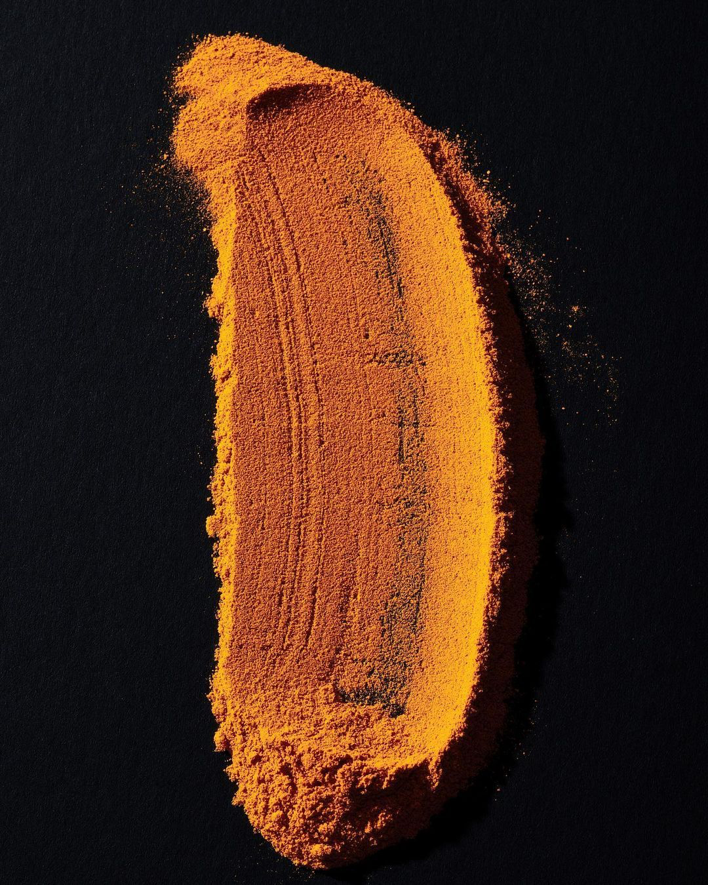

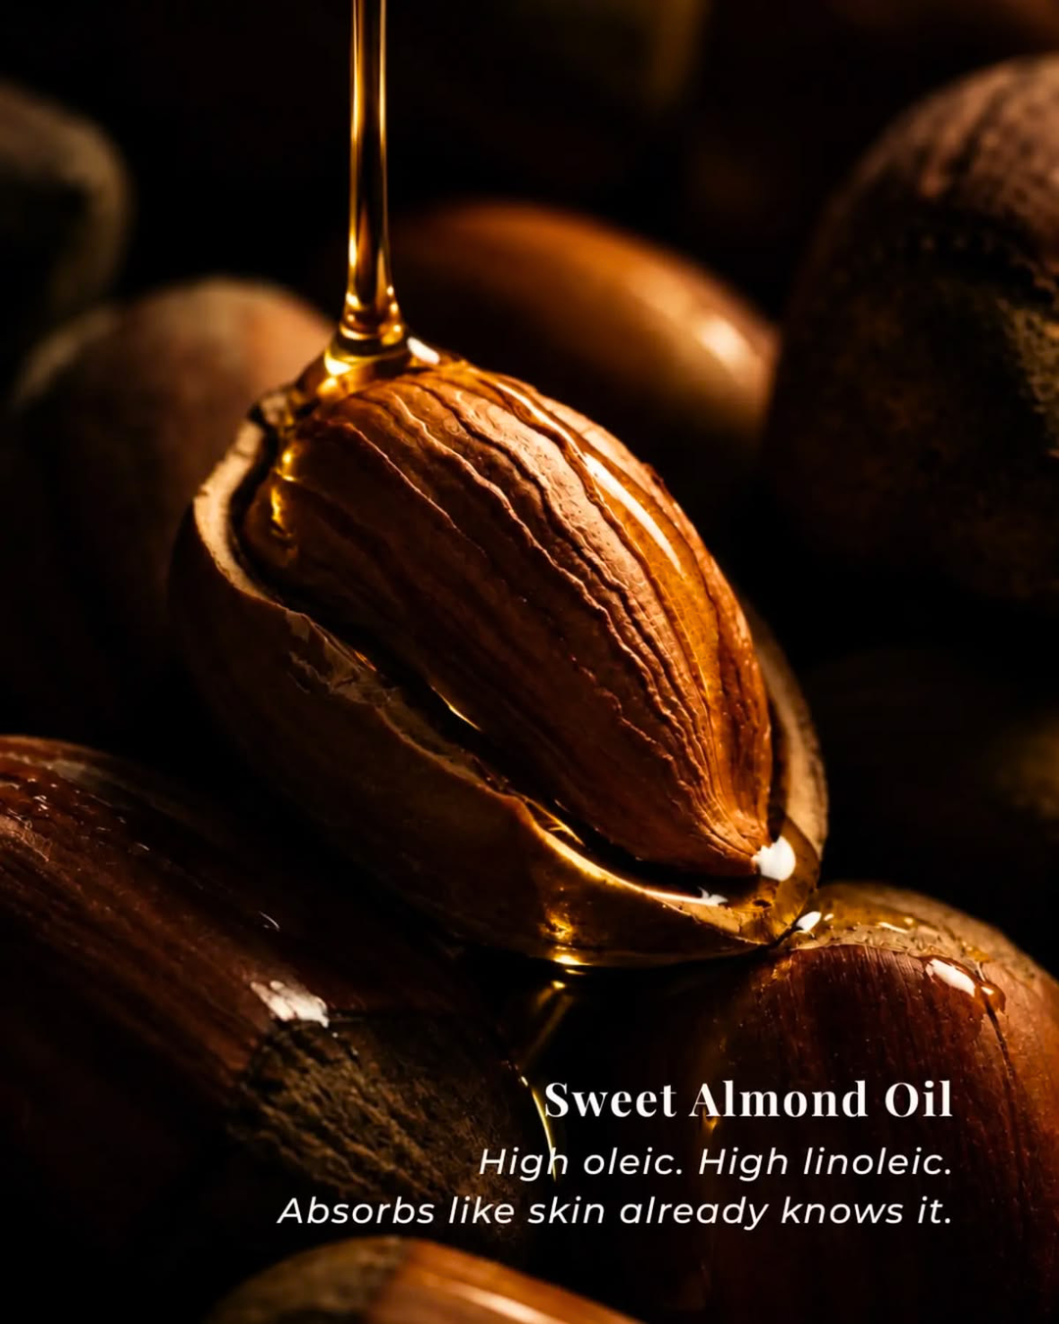

Strategic Recommendation
From misplacing AI into mastering it as an analytical tool
Q1
Q2
Q3
A Ritual Profile, Vay Sound agent and a microtool chord map that explains its ingriedients
AI performs the ritual; humans keep the voice
Fix owned journeys before adding new channels
Q4
Q5
Q6 & Q7
Ritual pages as the source of truth for agents
One north star: re-ritualized clients
Verified practitioners and community formats

Slide 7
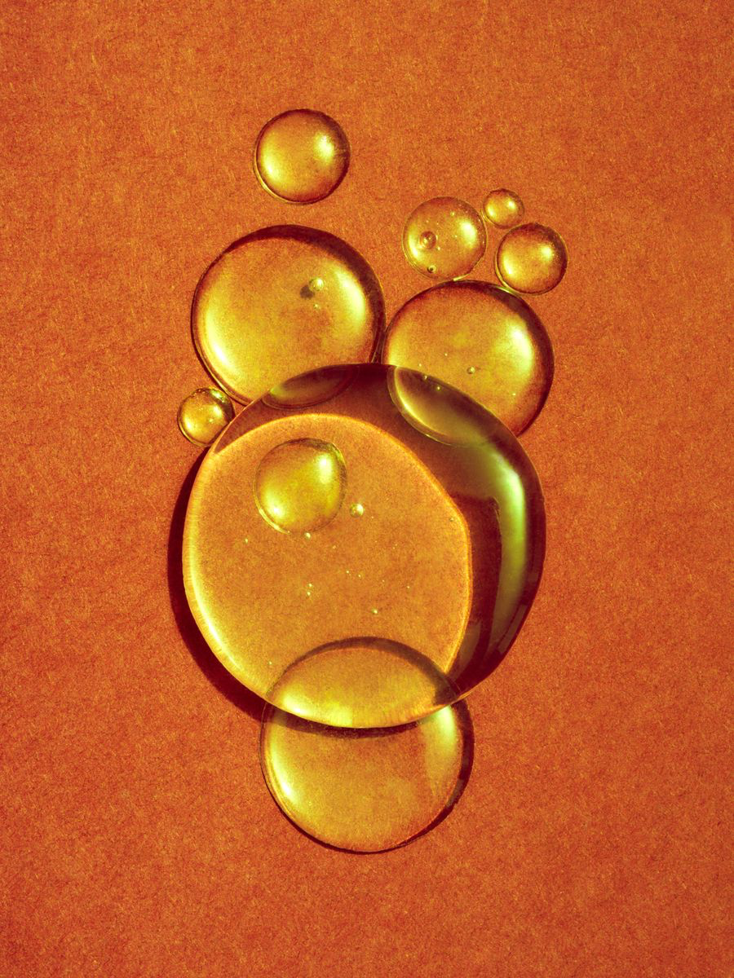

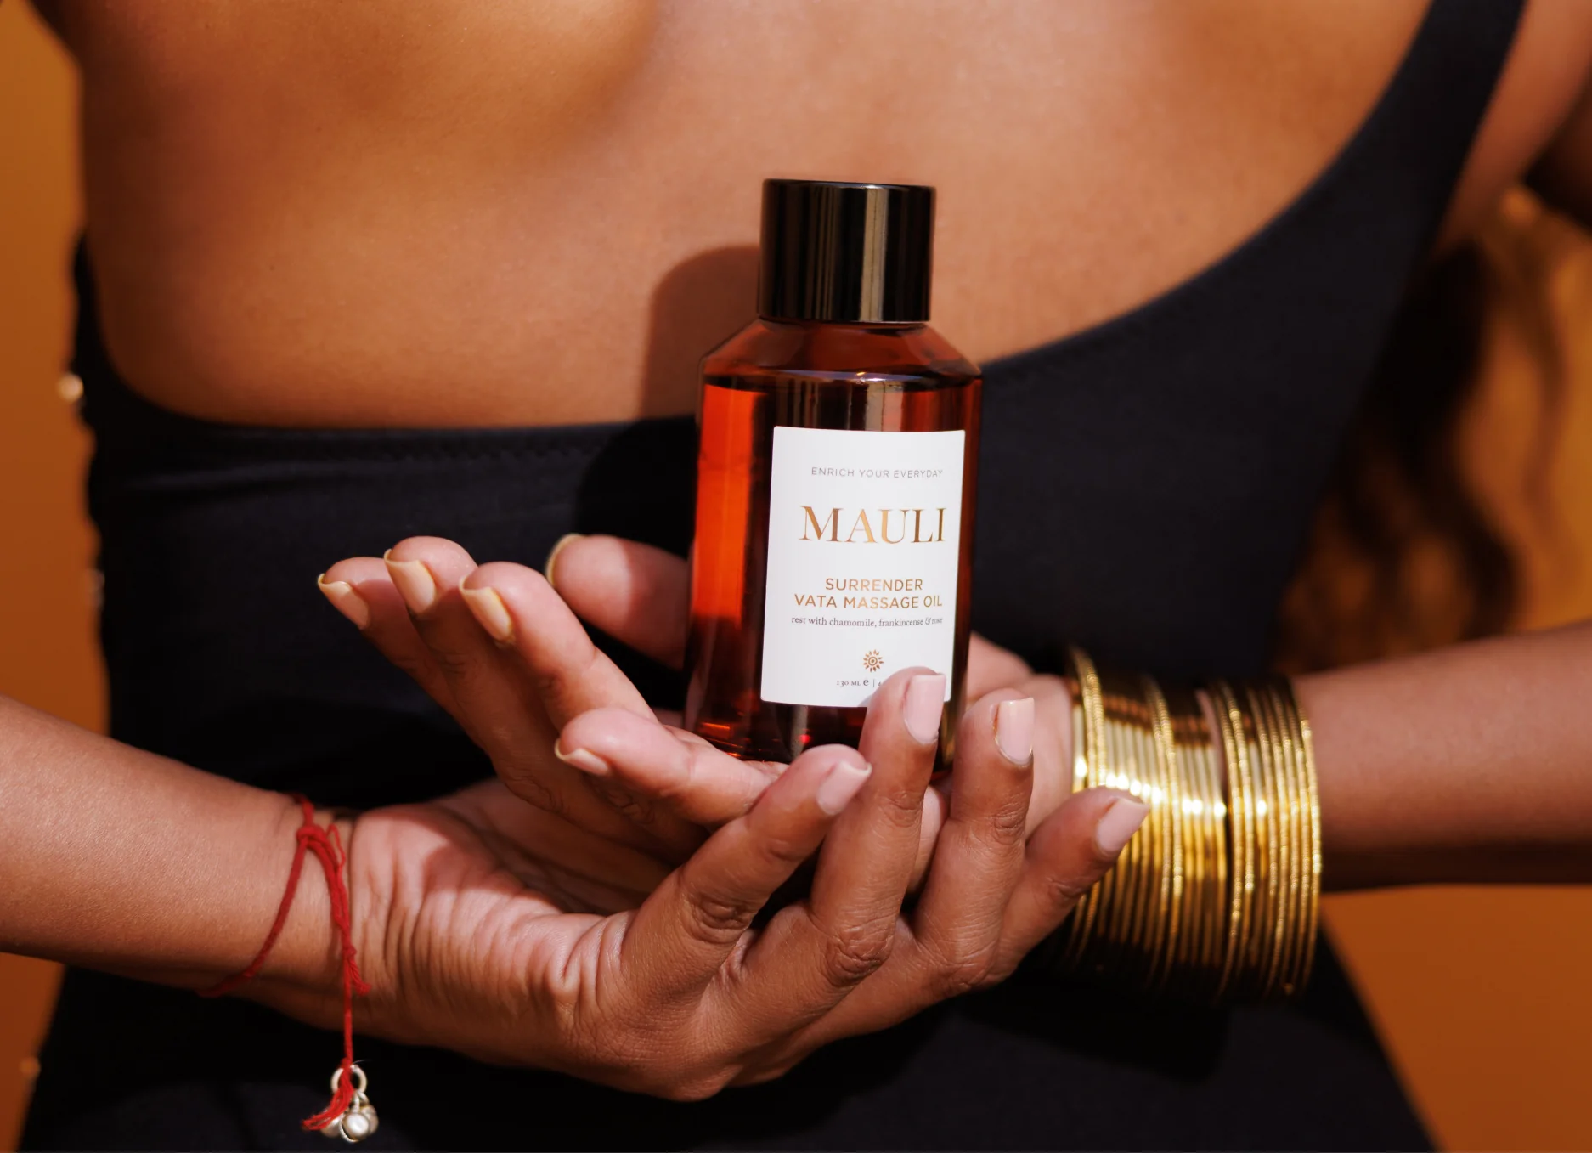
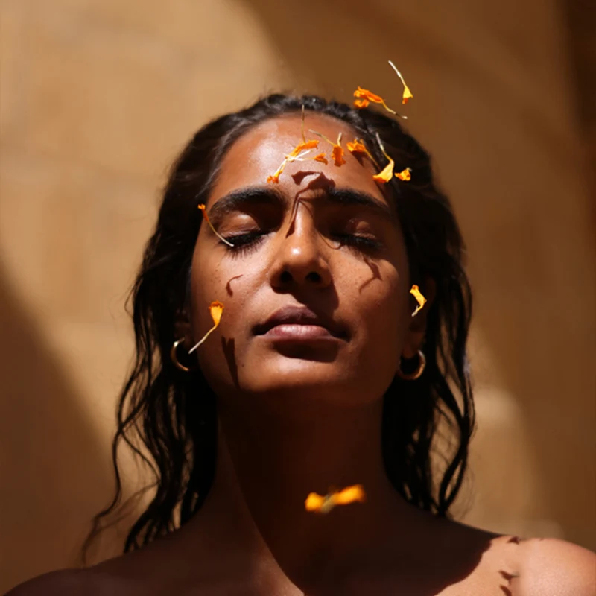
Metric Pillars
How to know the strategy worked?
AI PRESENCE
QUIZ TO RITUAL
REPEAT RATE
PARTICIPATION
Cited more in category answers, with zero wrong prices or claims
Quiz-to-ritual purchase within 30 days, no sold-out picks
At or above 54%, even as new channels launch
Members with 2+ meaningful Mauli interactions in 30 days

Slide 8
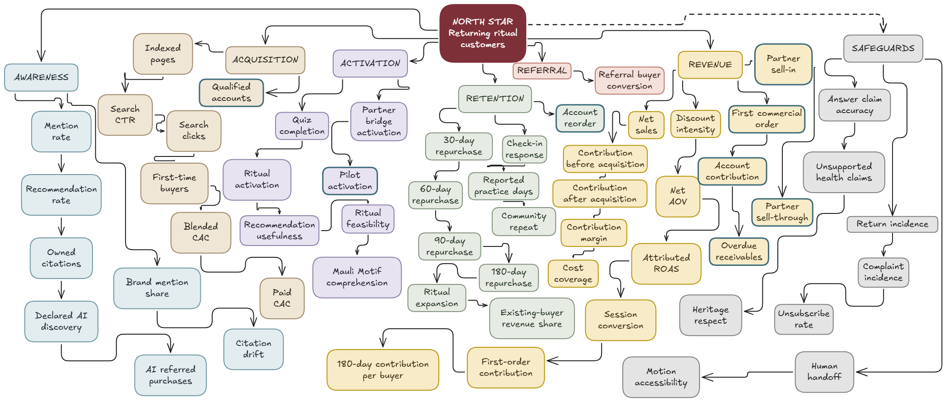
Metric Examples

Slide 9
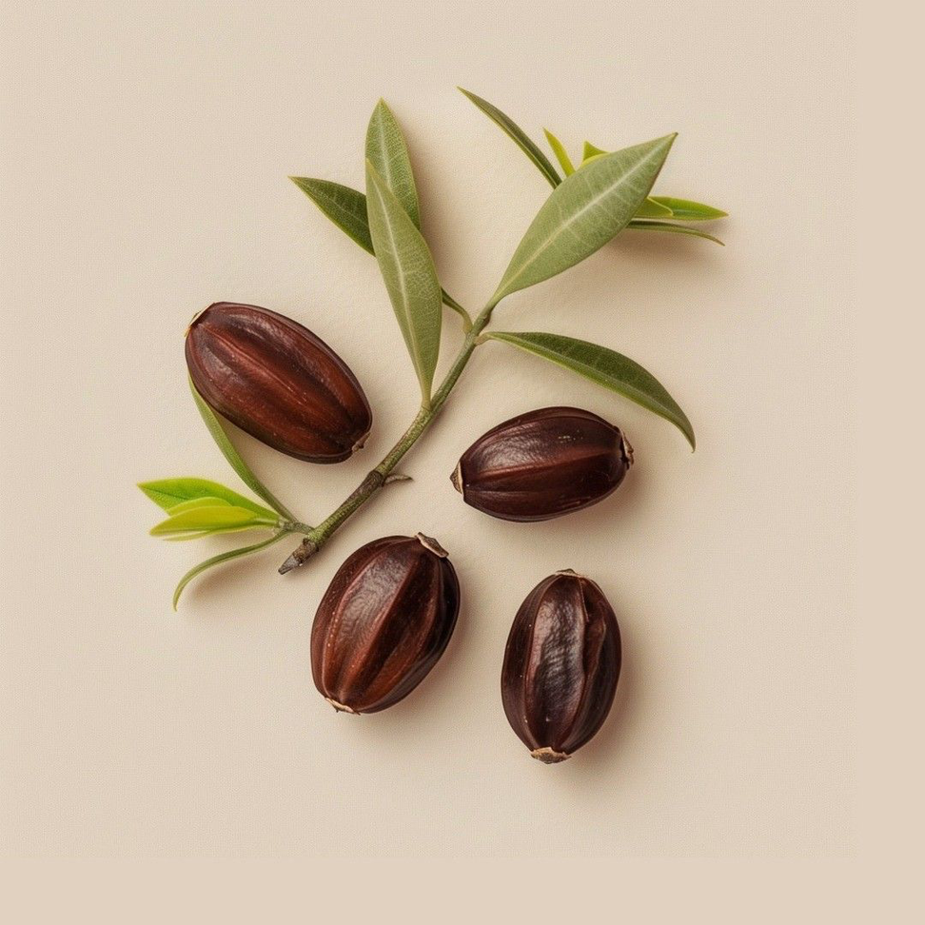
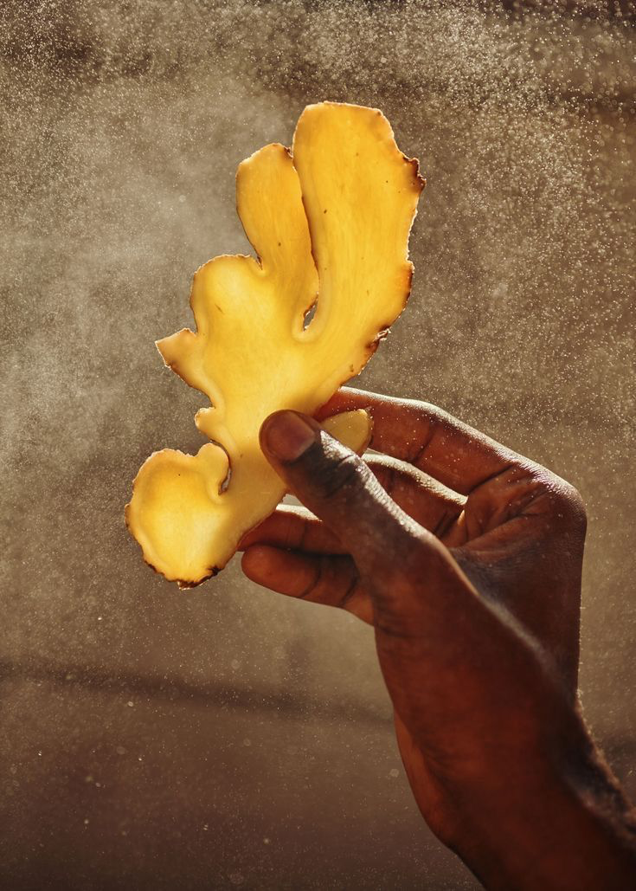
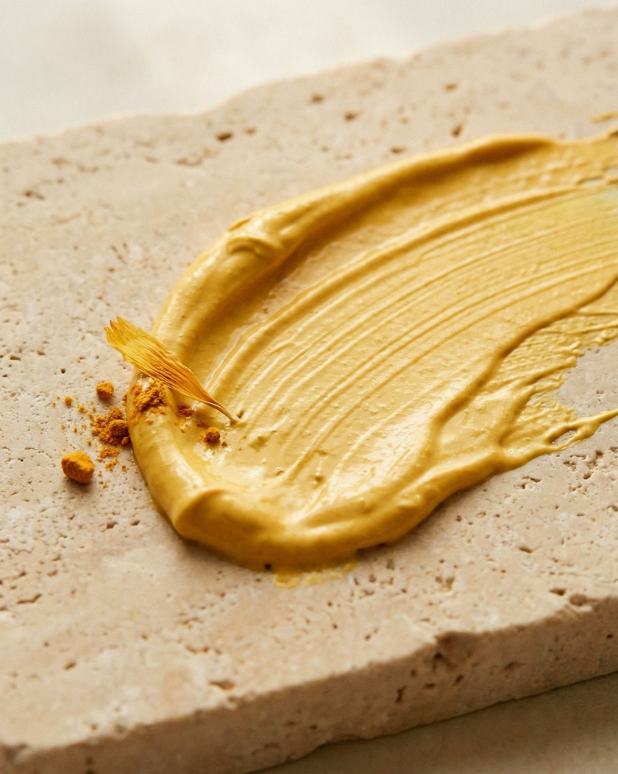

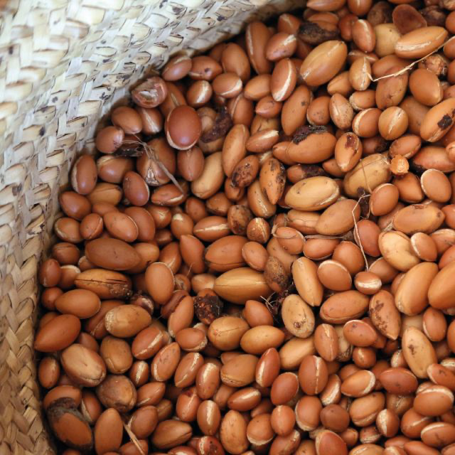
Strategically Avoid
What we are not recommending for now, and why?
Q1
Q2
Q3
Q5
Q6
Q7
WE AVOID: AI-MADE INFLUENCERS OR CONTENT (Q1) · PROFIT-LED QUIZ PICKS (Q2) · RETAIL B2C AND TIKTOK SOCIAL MARKETPLACE (Q3) · FOLLOWER & INFLUENCER BRAND (Q5, Q7) · AN OPEN THERAPIST MARKETPLACE (Q6)

Slide 10
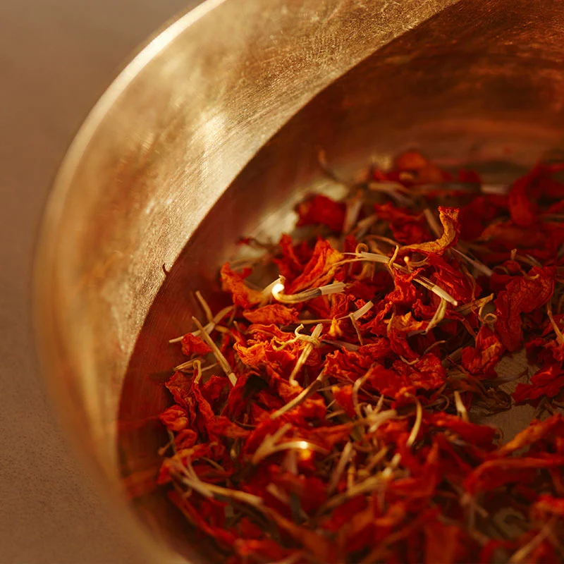
Conclusion
WHAT WE RECOMMEND
WHAT IT PROTECTS
  Extend the ritual before widening the range
  AI performs the ritual, the human voice makes it felt
  Measure repeat and participation, not attention
  ONE APPROVED RECORD PER RITUAL, PERMITTED CLAIMS ONLY
  NO SYNTHETIC ANITA VOICE, INFLUENCERS OR TESTIMONIALS
  HEALTH QUESTIONS ALWAYS GO TO A PERSON
NEXT 12 MONTHS
  Months 0-3: baselines, claims audit, quiz linked to stock
  Months 3-6: ritual pages, Ritual Profile pilot, community
  Months 6-12: practitioners lead live rituals

Slide 11

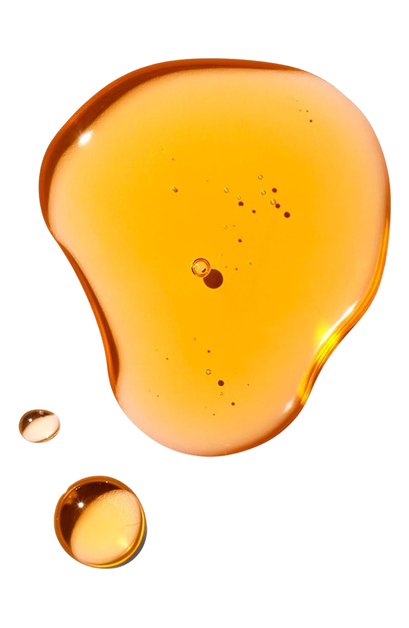
Thank You

Slide 12
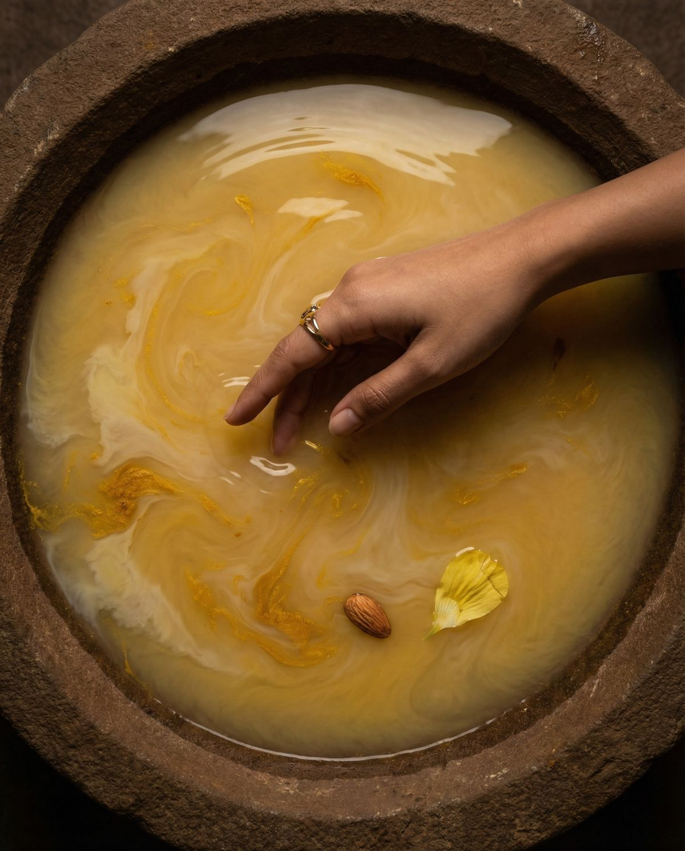

The Project
The Appendix →

Slide 13

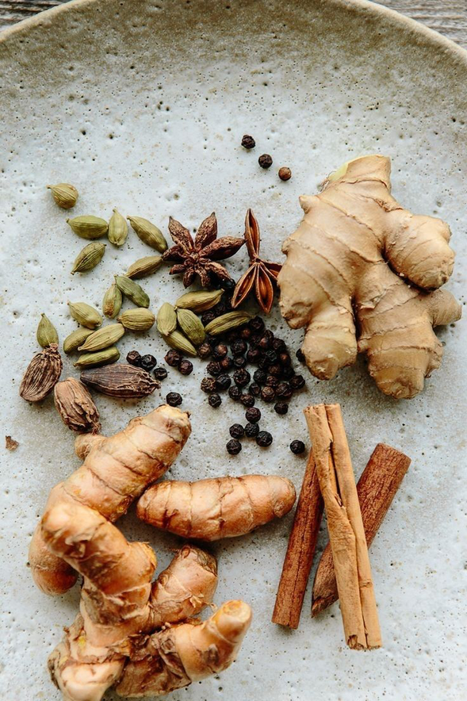
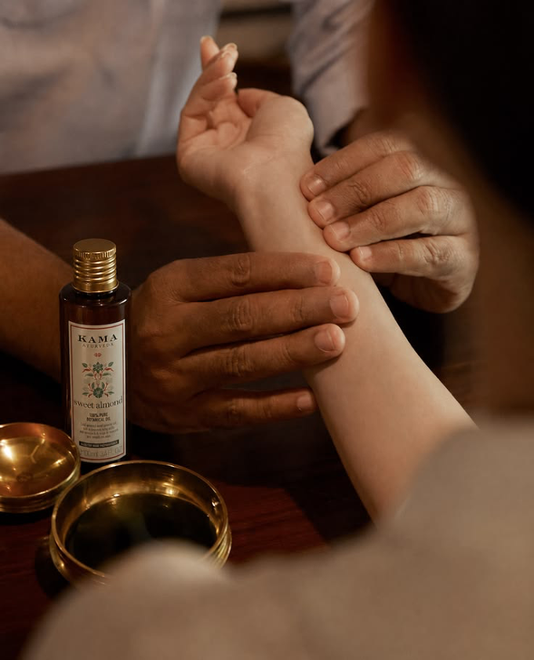
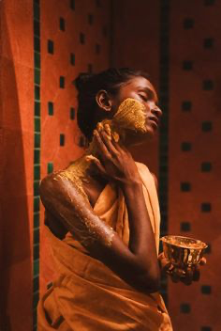
Customer Segmentations
The Art Of Returning
TREND-LED COLLECTORS
ROUTINE SELF-CARERS
PRAGMATIC LOYALISTS
Driven by aesthetics & virality
Daily wellness-focused users
Trust-led, habit-driven buyers

Slide 14
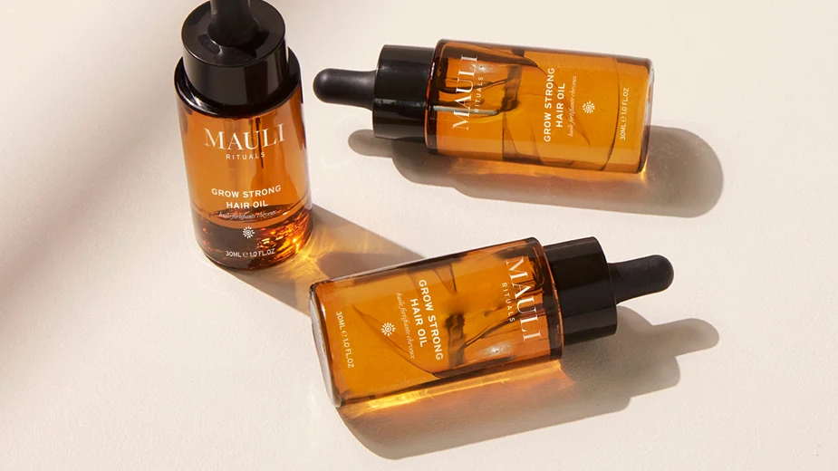
Q1
AI without losing the personal touch
AI PERFORMS
HUMAN VOICE
REAL PEOPLE
DISCLOSED
EVIDENCES
  GEMINI: WRONG PRICES OR CLAIMS IN 7 OF 10 ANSWERS, CHATGPT IN 1 OF 10
  RECORDED CLIPS OF ANITA AND PRACTITIONERS ON RITUAL PAGES
  NO INFLUENCERS OR TESTIMONIALS
  SYNTHETIC VOICE ONLY FOR REORDER REMINDERS, NEVER ANITA'S WITHOUT CONSENT

Slide 15
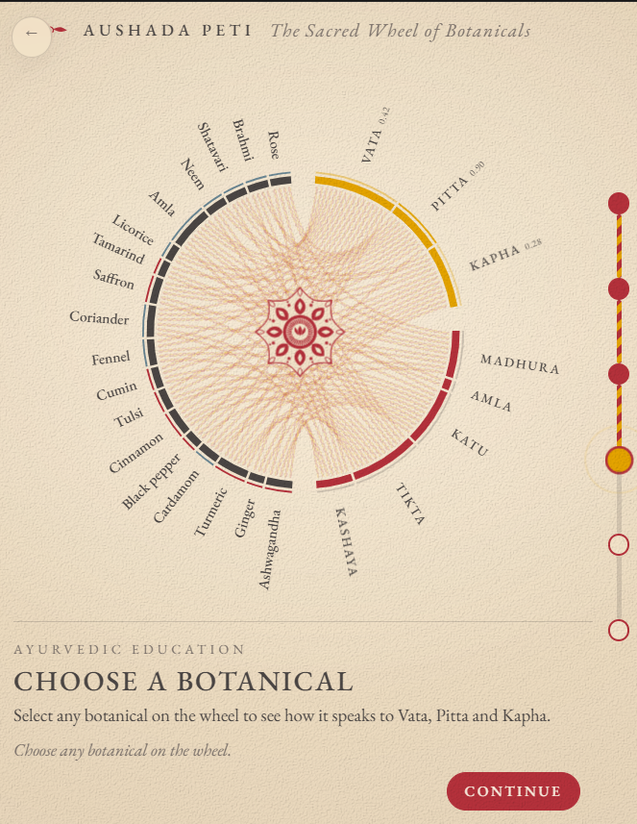

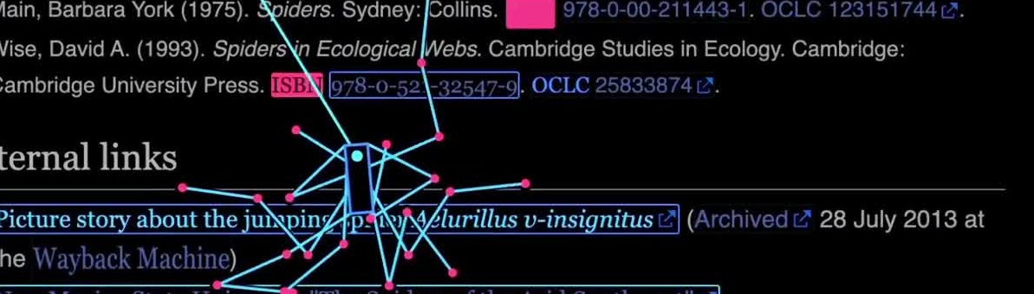
Personalisation at scale
QUIZ THAT EXPLAINS
VAY
  Decision model chooses from live stock; language model only explains
  Fit and stock rank products, margin never does
  Health questions go to a person
RITUAL PROFILE
Notes:
Make the individual feel like they're the only one in the whole world the brand is talking to

Slide 16

VAY
AI AGENT
Hyper Personalised on Ayurveda
AI Voice Agent

Slide 17
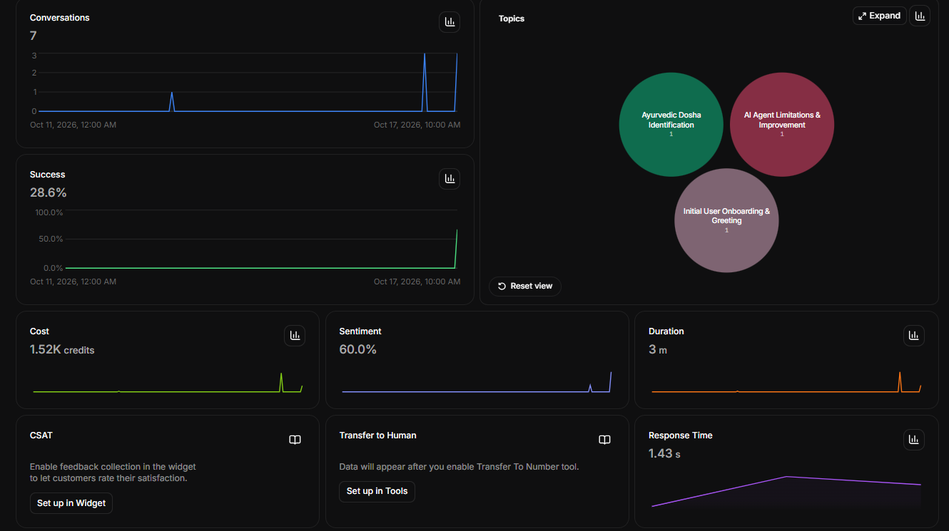
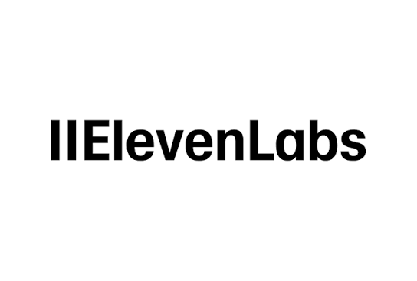

Slide 18
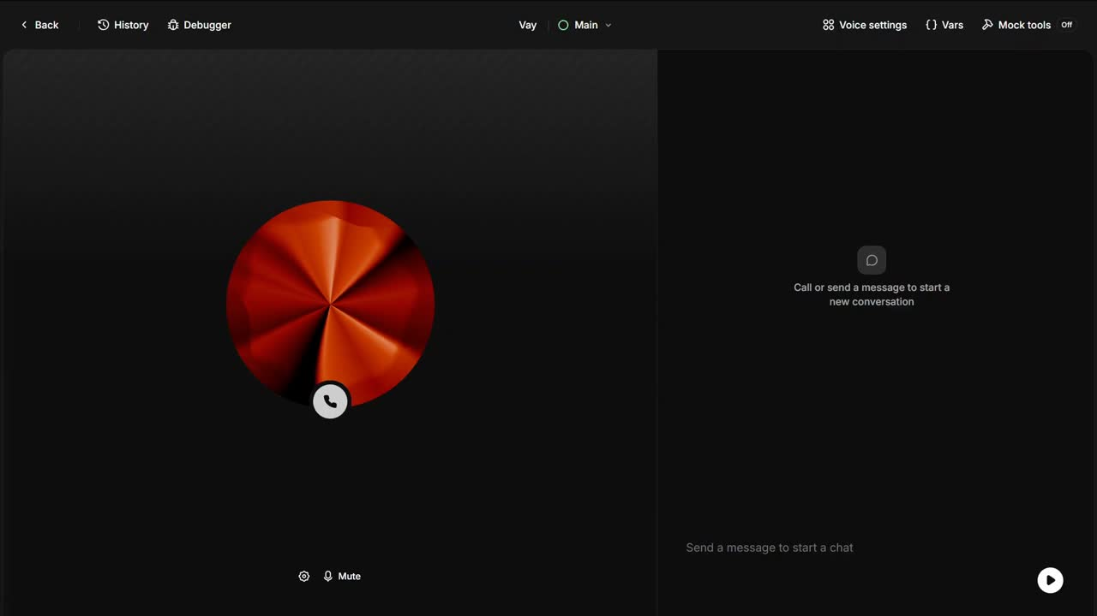
Demo Video- VAY

Slide 19
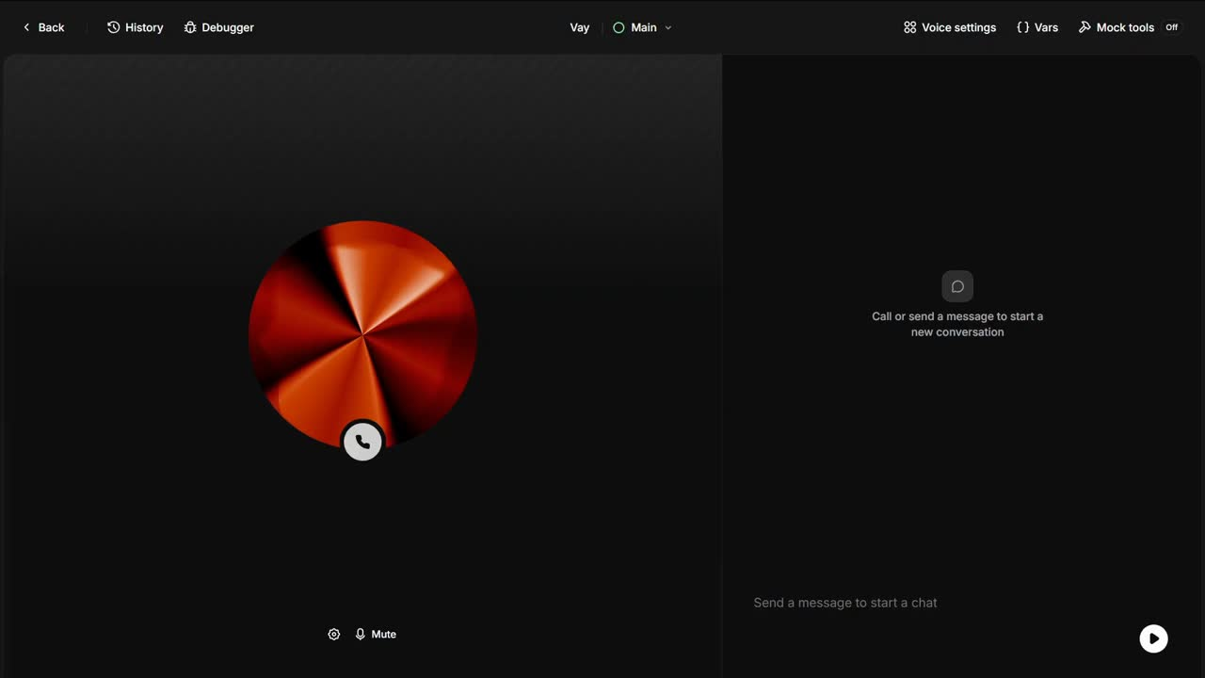
Demo Video 2
Jailbreaking- VAY

Slide 20

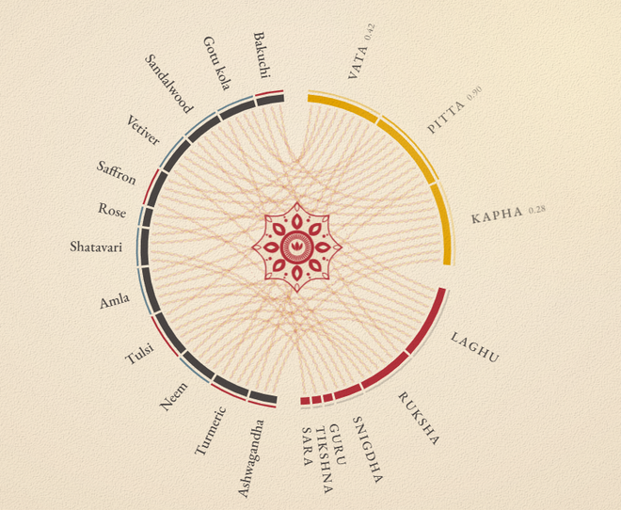
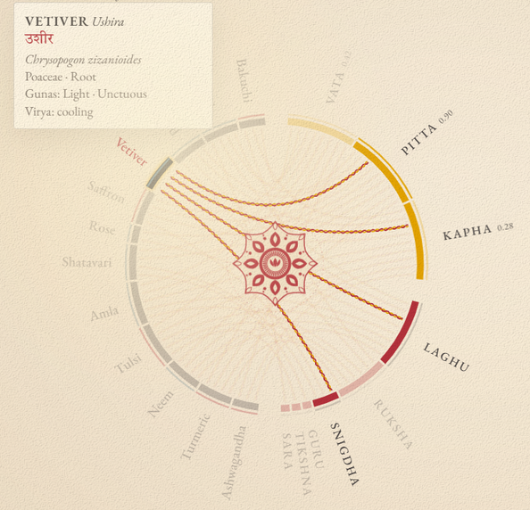
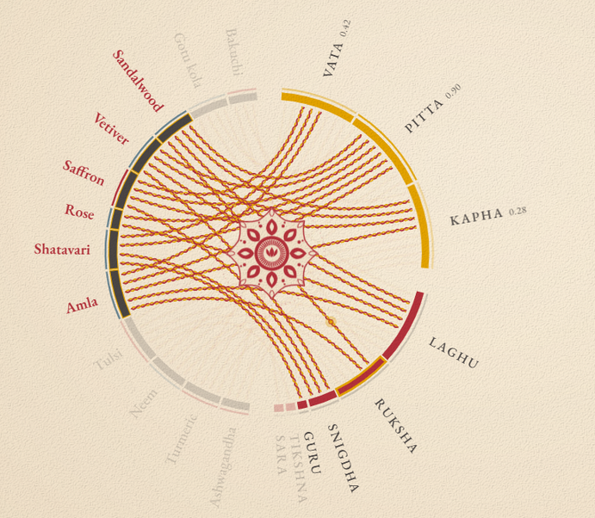
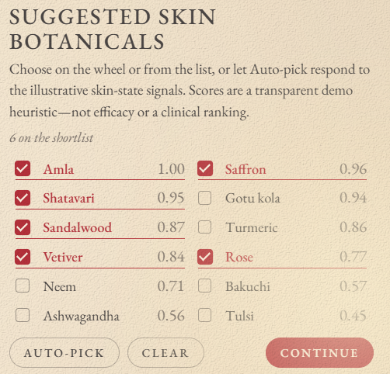
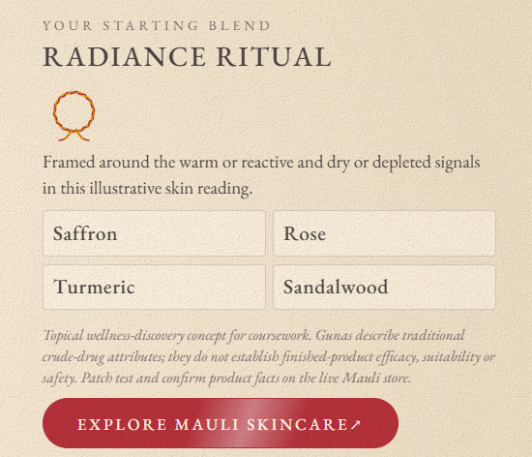
WHEEL OF BOTANICALS
Aushada Peti

Slide 21
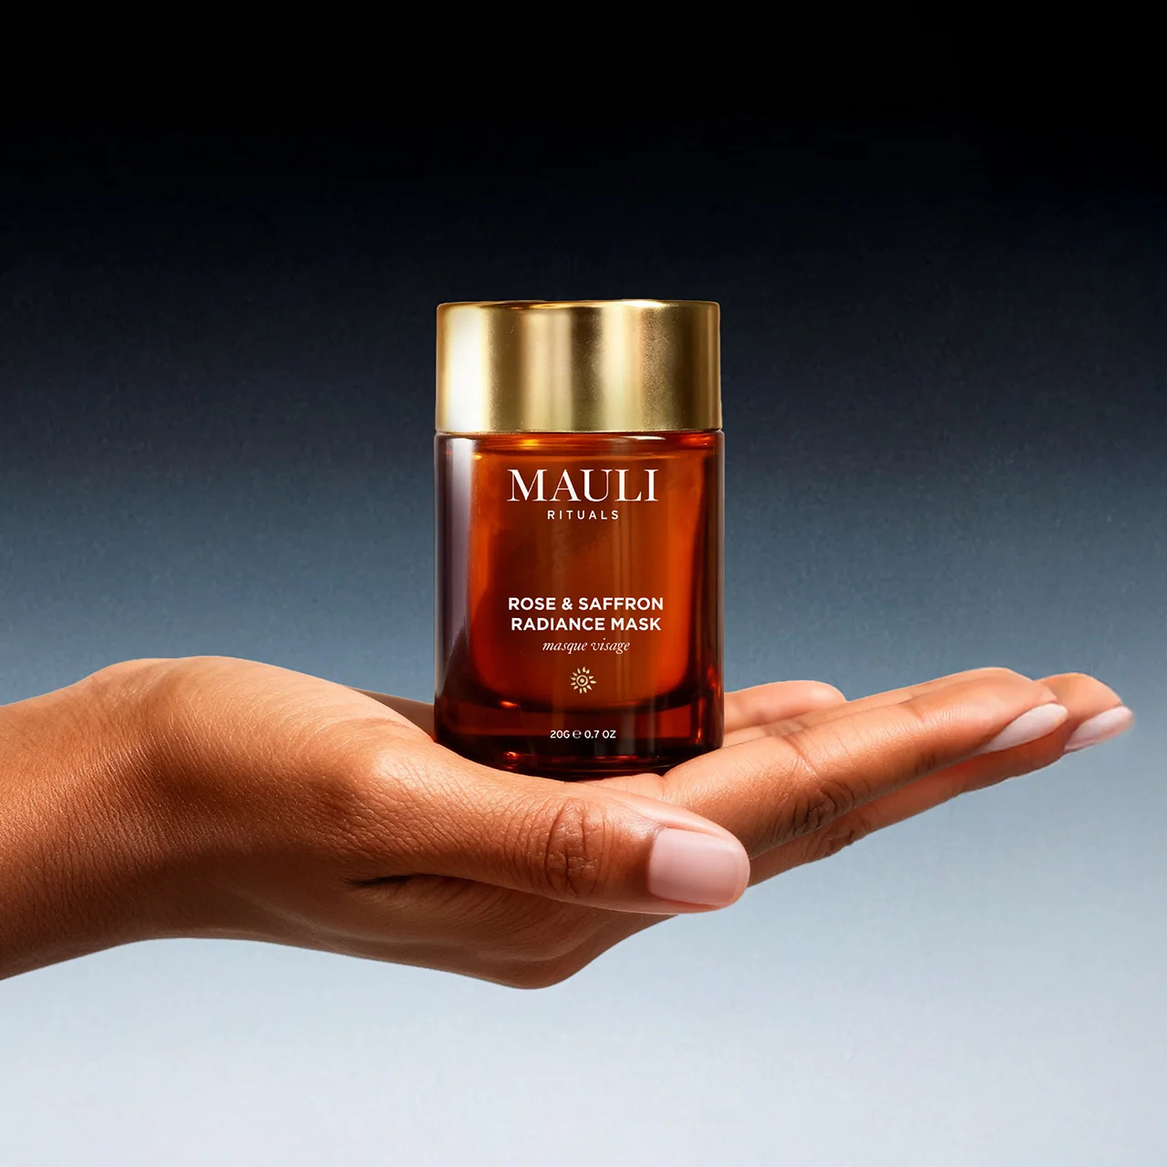
From Customer Acquisition to Customer Retention
Reducing paid dependency by strengthening repeat purchases and owned-channel relationships.
Our Recommendations
Strategic
Priorities
The Challenge
  72% of marketing budget spent on Meta
  Customer acquisition costs up 31%
  20% discounts reduce profit margins
  High acquisition costs make repeat purchases essential
  Personalise: Dosha-based emails, rituals and repurchase reminders
  Connect: Convert Instagram followers into email subscribers through the dosha quiz
  Retain: Replace discounts with exclusive gifts or ritual sets
  Maximise existing channels: website, email and dosha quiz
  Measure email clicks and conversions, not just open rates
  Develop the therapist community as a next step
  Deprioritise expensive new channels for now
Mauli should focus on building long-term customer relationships while reducing its dependence on paid advertising.

Slide 22

Margin Leaks
Where to execute with limited resources?
72%
Of marketing spend goes to Meta; the first order is near breakeven
£17-£22
Left from an £87 sale at Space NK terms, before product and logistics costs
54%
Repeat rate: profit sits in repeat orders, not the first

Slide 23

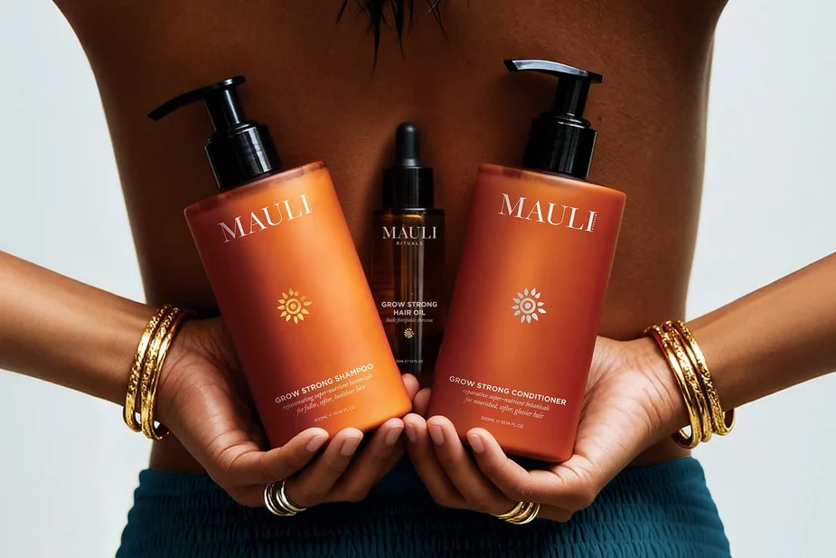
Q4
Emerging technology for communication & retail
RITUAL PAGES
SHOPIFY UCP
LIVE QUIZ
PROFILE
EVIDENCES
  ONE APPROVED RECORD PER RITUAL: PURPOSE, DOSHA, STEPS, PRICES, PERMITTED CLAIMS
  STRUCTURED DATA THROUGH SHOPIFY'S UNIVERSAL COMMERCE PROTOCOL
  QUIZ PICKS FROM LIVE STOCK; AI CANNOT ADD OR REORDER PRODUCTS
  PROFILE EMAILS EARN ABOUT 6X REVENUE PER RECIPIENT ($2.09 VS $0.32)

Slide 24
Q5-Redefining Success
Future Metrics, Roadmap & Recommendation
NORTH STAR
AI VISIBILITY
AI ACCURACY
  Whole ritual bought, back within 6 months
  10 monthly questions in ChatGPT and Gemini
  No wrong prices or unapproved claims
QUIZ TO RITUAL
REPEAT RATE
PARTICIPATION
  Quiz-to-ritual purchase within 30 days
54% today: at or above, as channels launch
  2+ meaningful interactions per 30 days

Slide 25
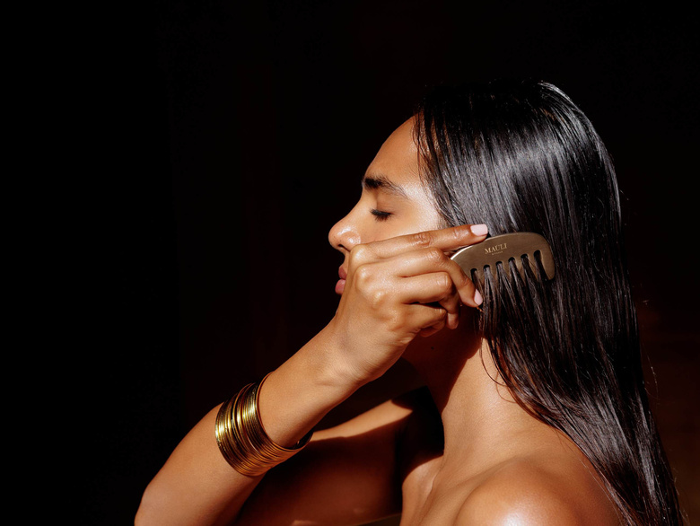
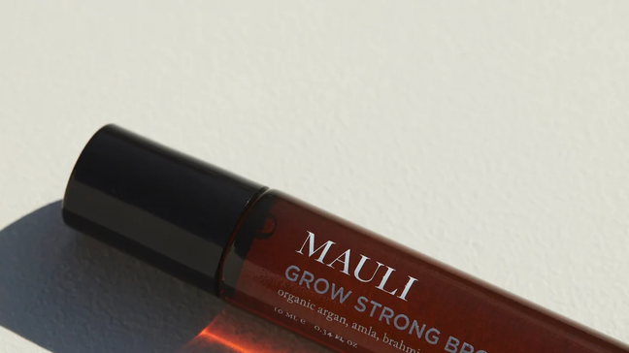


Therapist Community Platform
Verified access → Ritual training → Flexible replenishment → Community participation
VERIFIED
ACCESS
RITUAL
TRAINING
FLEXIBLE REPLENISHMENT
COMMUNITY PARTICIPATION
Dedicated professional area on Mauli’s website • Qualifications and insurance checked • Approved trade accounts
Tiers suited to practice size • Adjustable quantities and delivery frequency • Options to skip or pause
Product and treatment guidance • Recorded ritual demonstrations • Practitioner Q&A sessions
Share treatment feedback • Join practitioner sessions • Contribute approved ritual content

Slide 26
Turn Instagram reach into an owned Mauli Ecossytem
Instagram should be the doorway to community, not the community itself.
DISCOVER
IDENTIFY
PARTICIPATE
CONVERT
RETAIN
  Return to Self
  Ask Anita
  Ayurveda Did It First
  Practitioner Rituals
  Customer Stories & UGC
High-Reach Instagram Content
↓
Mauli Profile
Personalised VAY / Dosha Quiz
↓
Understand customer needs and interests
Relevant Mauli Ritual / Product
↓
Purchase
Repeat Participation
↓
Repeat Purchase
↓
Referral & Advocacy
CUSTOMER JOURNEY
RECOMMENDATION
High-Reach Reel → Profile → VAY Quiz → Community Participation → Mauli / Practitioner Interaction → Purchase → Repeat Purchase / Referral
Do not build another audience.
Build a system that converts the audience Mauli already has into active participants in the Mauli ecosystem.

Slide 27

Q7-Building Community
Emotion → Ayurveda → Mauli → Ritual → Participation → Purchase
WEEKLY
RECORDED
Ask Anita, Ayurveda Did It First, Return to Self
Anita and practitioner clips on ritual pages
Metric
LIVE
MONTHS 0-3
MONTHS 3-6
MONTHS 6-12
Verified practitioners lead rituals from month 6
Baselines, claims audit, quiz linked to stock. Start weekly Ask Anita
Ritual pages, quiz explanations, Ritual Profile pilot, community formats
Practitioners lead live rituals. Move budget from non-driving elements
Community plan
MEASURED
PROTECTED
Participation: 2+ interactions per 30 days
Real people only: no synthetic voices or influencers
FOUNDATION
LAUNCH
SCALE

Slide 28
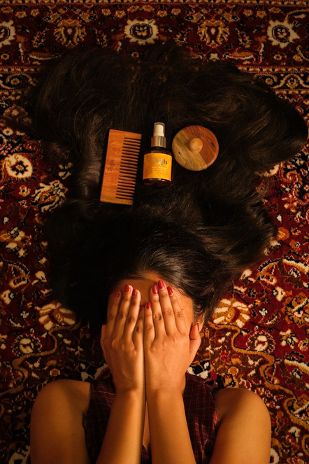

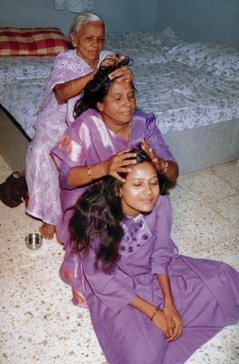
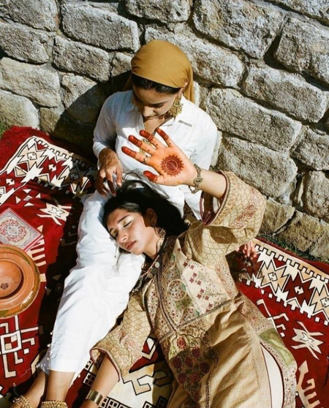
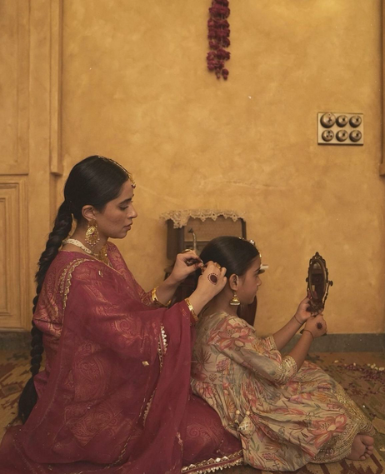

Social Campaign Goals
Creating a World You Can Relate To Your Roots
Cohesive Brand World
Use seasons as the organizing system so consumers can enjoy rituals
Culturally Relevant
Reposition Ayurveda Rituals as more than a functional medicine
Build Community
Move from brand-to-consumer to brand-with-consumer
Drive Product Desire
Increase impulse purchases and repeat buying
Balance Heritage (care, accessibility, trust) + Modernity (flavors, partnerships, experiences)
Core Values

Slide 29



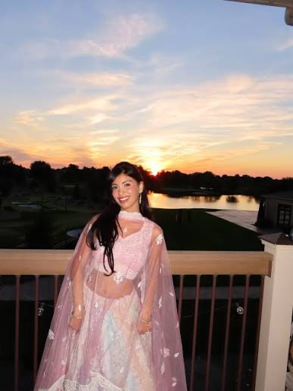
Ambassadors
Ambassador Archetypes
SELF-CARE
RITUAL
GEN Z
CULTURE
CONFIDENCE & IDENTITY
COMMUNITY CREATOR
INDIAN HERITAGE
DRIVEN
TAM KAUR
SID AND LISTEN
SIMONE ASHLEY
ASTHA RAJYAGURU
Perfect embodiment of self-care as a ritual
High Gen Z recognition
Aligns with beauty, confidence, and identity
Strong connection to Beauty communities

